Slide 1
SLIIT Students’ Attitude and Preferences Regarding Social Media Influencers.
English For Academic Purpose (IT1080)
Dineth T. H. V - IT22002174
Anuradha D. P. G. C - IT22315296
Warunika R. S - IT22349460
Hansara K. D. K. U - IT22352026
Nisfa N. M. F - IT22909428

Slide 2
1. INTRODUCTION
Who are Social Influencers?
“a variety of third parties who exercise influence over the organization and its potential customers”. [1]
Influencer Categories
Nano Influencers – following ranging 1K to 10K.
Micro Influencers – following ranging 10K to 100K.
Macro Influencers - following ranging 100K to 500K.
Mega Influencers – Followers more than 500K followers. [2]

Slide 3
2. METHODOLOGY
Method
Quantitative method is used to attain research objectives.
Population Technique
The research population was all the students of SLIIT in all 03 institutes. Its Population is around 500 students.

Slide 4
Sampling Technique
This research sample was from the Matara Branch out of all 03 branches. The size of the sample was 100 students.
The sampling technique used in this report is random sampling.
Primary Data Collection
In this research primary data collected using questionnaires.

Slide 5
Secondary Data Collection
This research was collected from various e-books, previous research articles, reports, and websites like Google scholar.

Slide 6
3. DATA ANALYSIS AND DISCUSSION
Data Analysis
Data collection and data analysis were collected by form of the survey/questionnaire.
Every information is illustrated below.

Slide 7
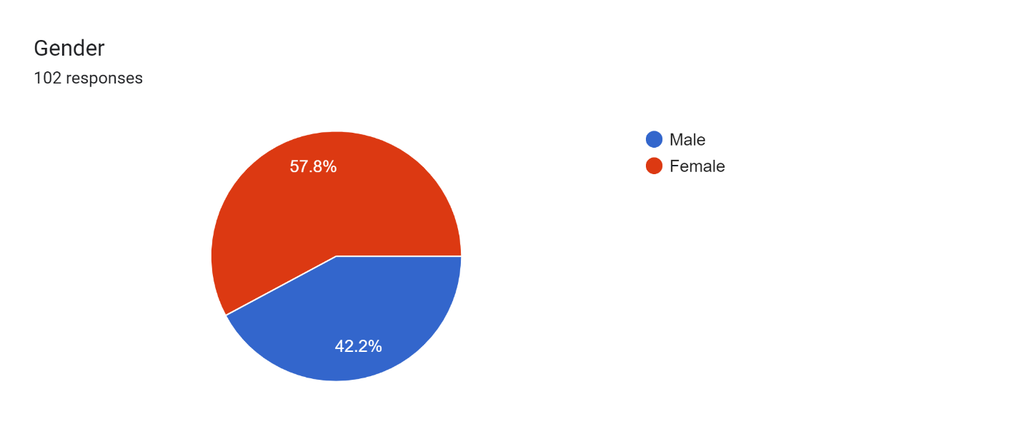
Gender

Slide 8
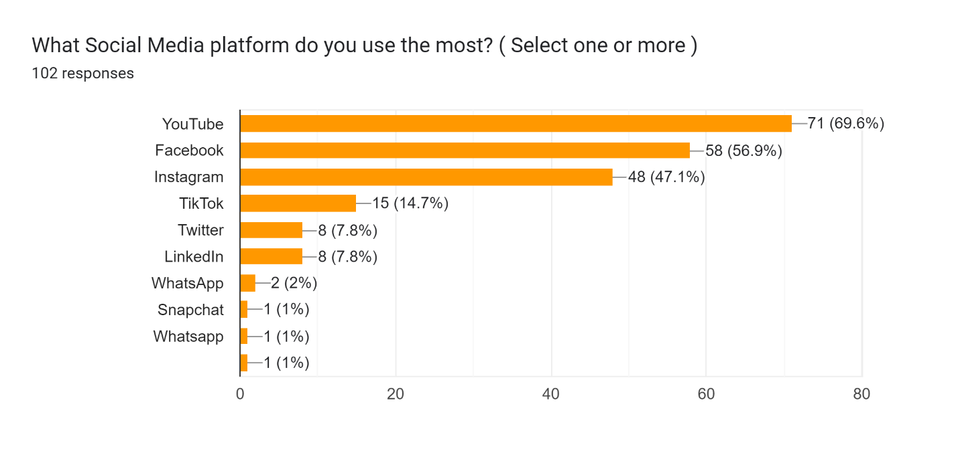
Most used social media platform.

Slide 9
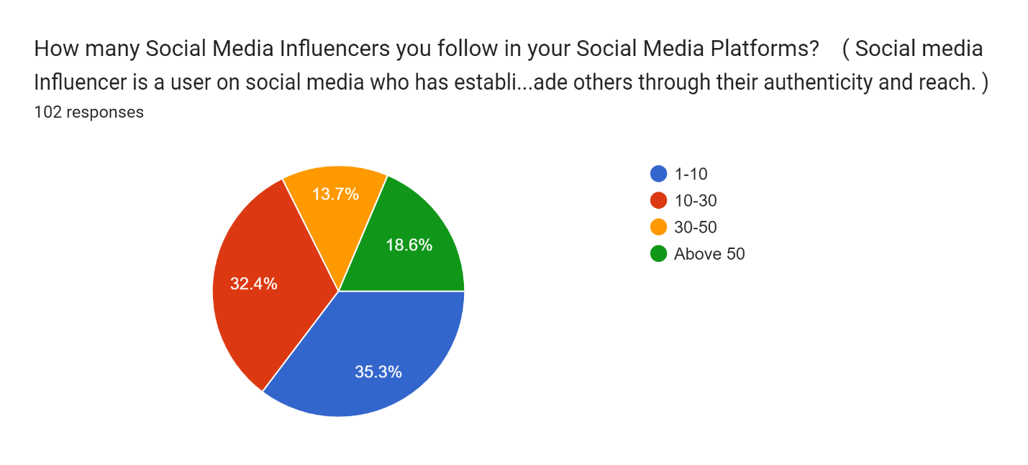
How many social media influencers are you following?

Slide 10
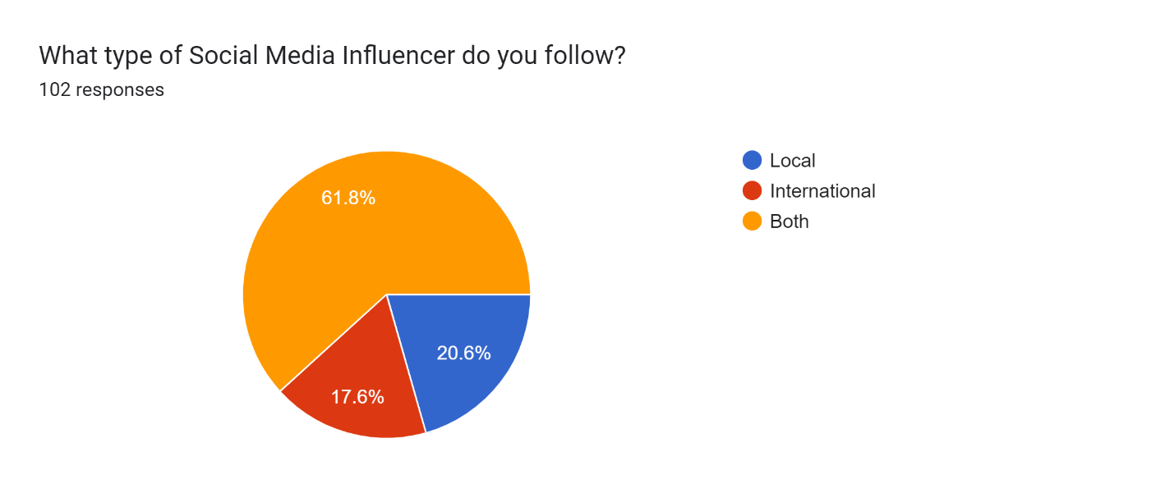
Type of social media influencers you follow.

Slide 11
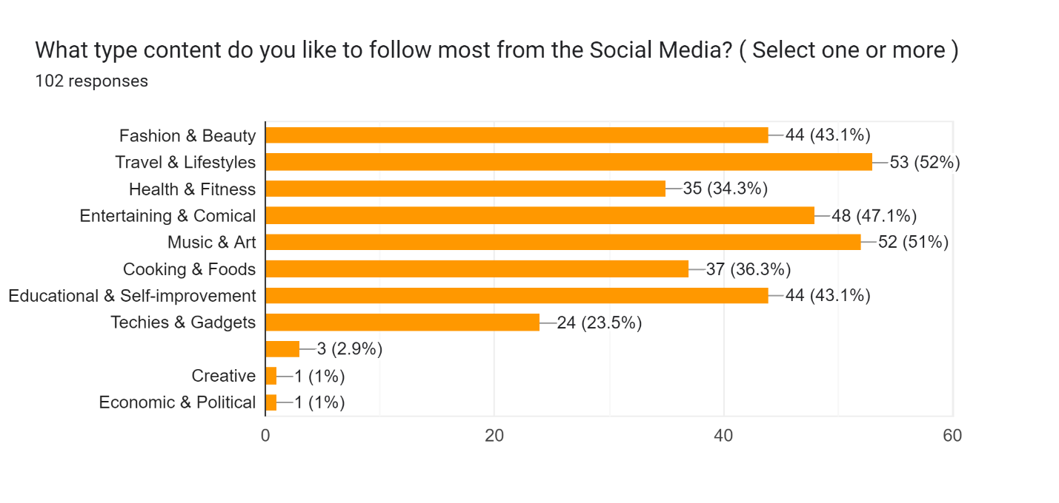
Type of content followed most in social media?

Slide 12
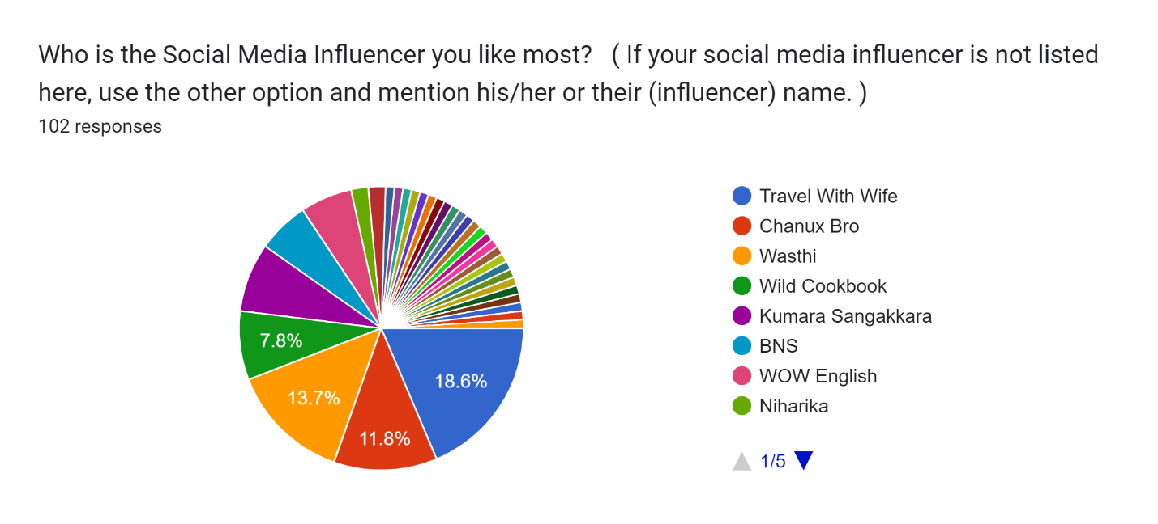
The most liked social media influencer.

Slide 13
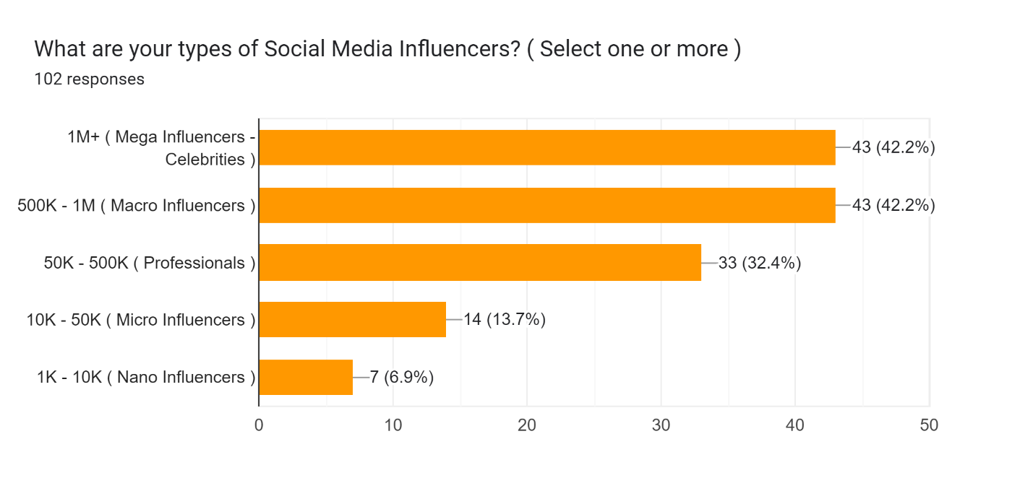
Type of social media influencer.

Slide 14
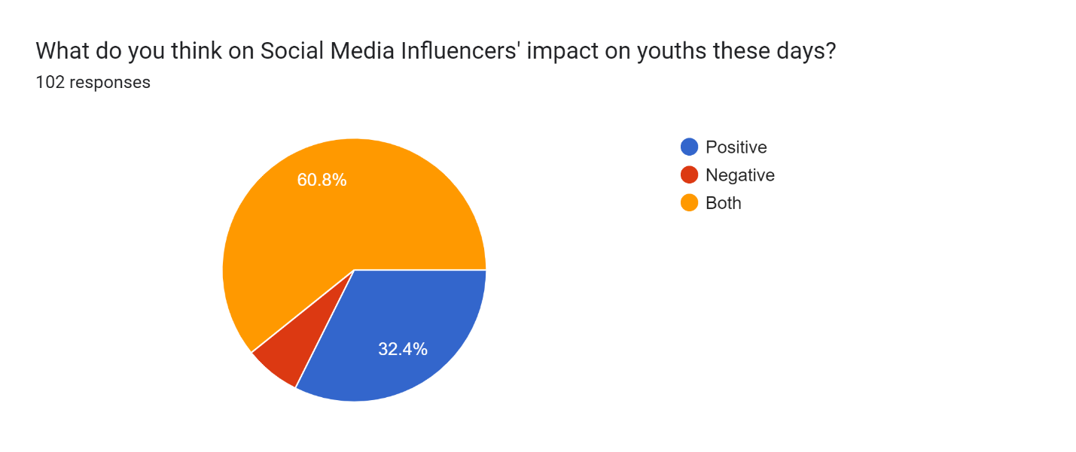
Impact on youths.

Slide 15
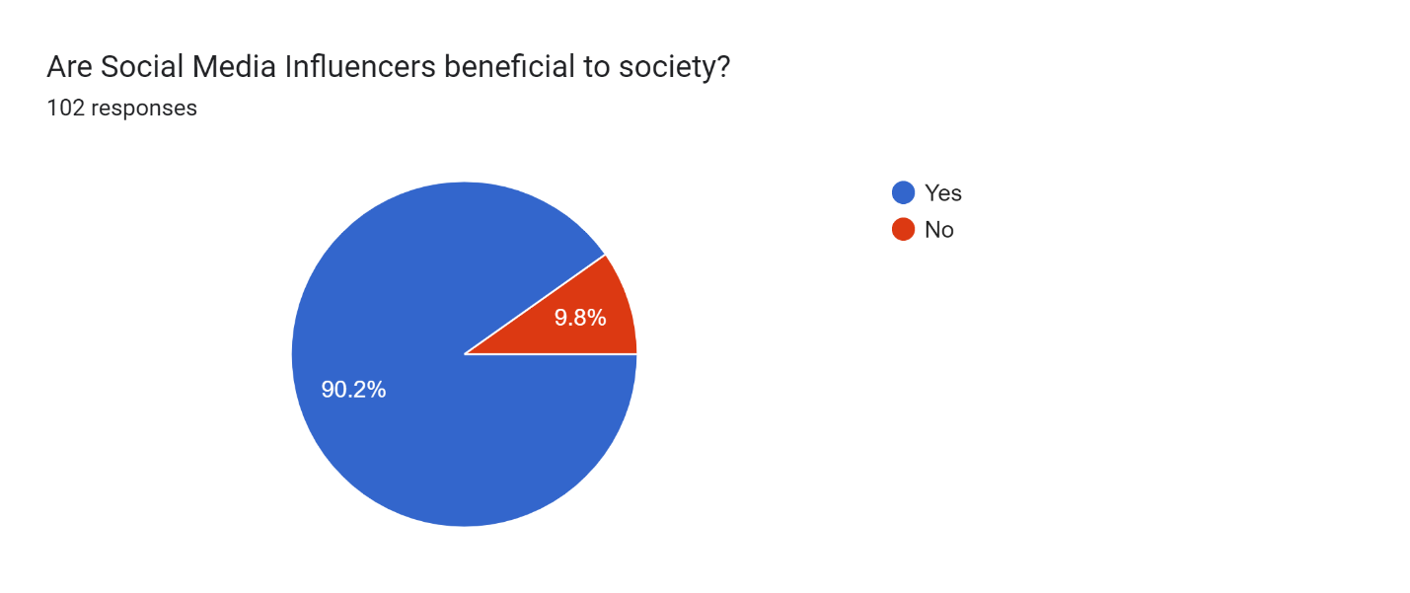
Are social media influencers beneficial to society?

Slide 16
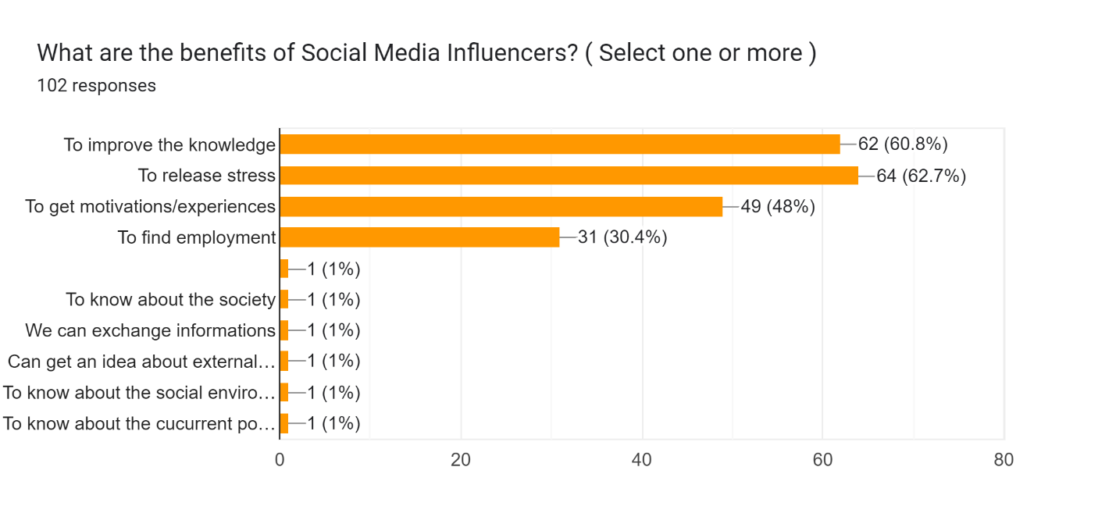
Benefits from a social media influencer.

Slide 17
Discussion
Gender of the respondents
Based on the gender of the respondents, the finding revealed that there are 58 (58%) females and 42 (42%) males amongst those who responded.
Students’ altitude of their response
Correlation in answers when it is related to their favorites.

Slide 18
4. CONCLUSION
The purpose of the study was a way to assess the effects of SLIIT Students’ Attitude and Preferences Regarding Social Media Influencers and this presentation is to present the conclusion which was drawn by using quantitative analysis.
Everyone has their own different opinions regarding social media influencers.
The findings from the study concurs with the information found as it relates to mainly of a person’s ability and dependance on influencers.

Slide 19
5. REFERENCES
[1] – Peck, Helen; Payne, Adrian; Christopher, Martin; Clarke, Moira. Relationship Marketing: Strategy and Implementation, Butterworth-Heinemann, 1999.
[2] – Maheshwari, Sapna (2008 – 11 - 11). “Are You Ready For The Nano Influencers?. The New York Times.

Slide 20
QUESTIONS?

Slide 21
Thank you all for your time.

